Slide 1

RESEARCH DESIGN

Slide 2

Exploratory Research Design:
Secondary Data

Slide 3

Outline
Overview
Primary Versus Secondary Data
Advantages & Uses of Secondary Data
Disadvantages of Secondary Data

Slide 4
Primary Vs. Secondary Data
Primary data are originated by a researcher for the specific purpose of addressing the problem at hand.
Secondary data are data that have already been collected for purposes other than the problem at hand. These data can be located quickly and inexpensively.

Slide 5
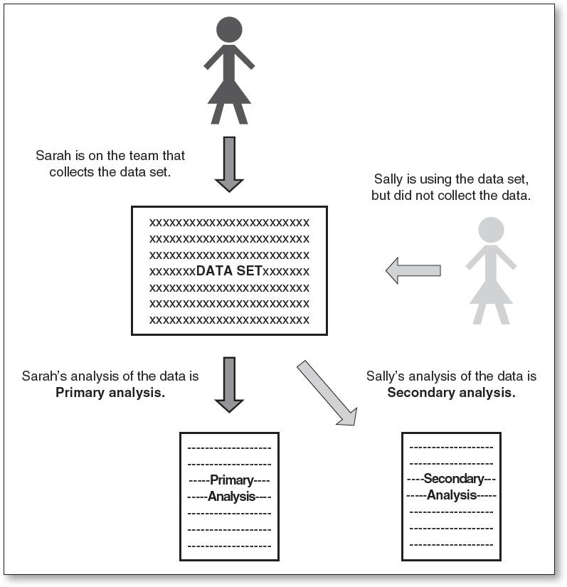
Namey, E. E., & Trotter, R. T. (2015). Qualitative research methods. Public Health Research Methods. Guest GS and Namey EE (eds). California: Sage.

Slide 6
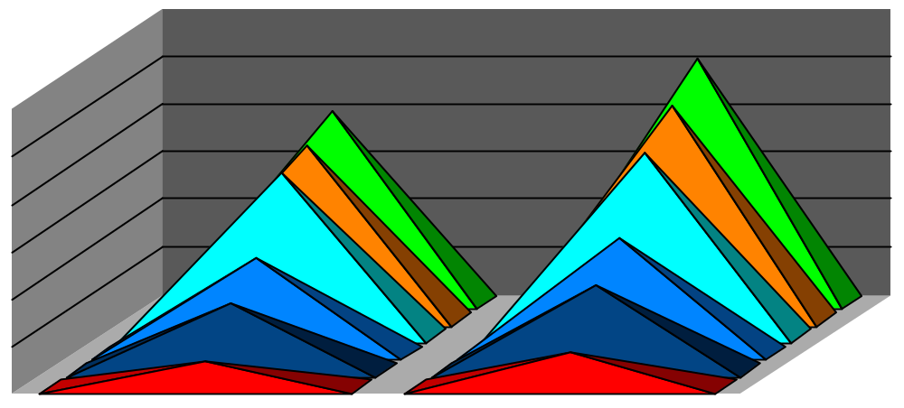

A Comparison of Primary & Secondary Data
Primary Data Secondary Data
Collection purpose For the problem at hand For other problems
Collection process Very involved Rapid & easy
Collection cost High Relatively low
Collection time Long Short

Slide 7
Uses of Secondary Data
Identify the problem
Better define the problem
Develop an approach to the problem
Formulate an appropriate research design (for example, by identifying the key variables)
Answer certain research questions and test some hypotheses

Slide 8
Criteria for Evaluating Secondary Data
Specifications: Methodology Used to Collect the Data
Error: Accuracy of the Data
Currency: When the Data Were Collected
Objective(s): The Purpose for Which the Data Were Collected
Nature: The Content of the Data
Dependability: Overall, How Dependable Are the Data

Slide 9
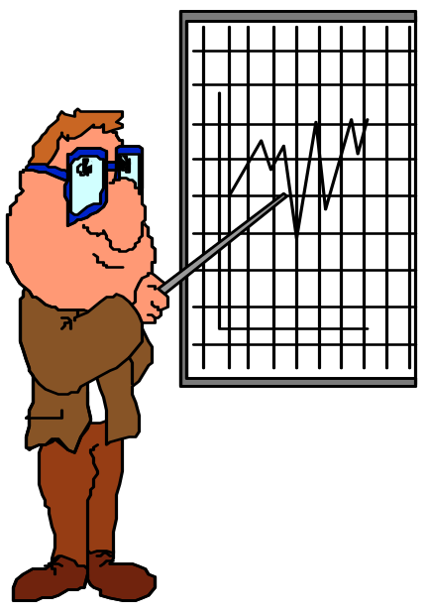
A Classification of Secondary Data
Fig.
Secondary Data
Internal
External
Ready to Use
Requires Further Processing
Published
Materials
Computerized Databases
Syndicated Services

Slide 10
Internal Secondary Data
Department Store Project
Sales were analyzed to obtain:
Sales by product line
Sales by major department (e.g., men's wear, house wares)
Sales by specific stores
Sales by geographical region
Sales by cash versus credit purchases
Sales in specific time periods
Sales by size of purchase
Sales trends in many of these classifications were also examined

Slide 11



Type of Individual/Household Level Data
Available from Syndicated Firms
I. Demographic Data
- Identification (name, address, email, telephone)
- Sex
- Marital status
- Names of family members
- Age (including ages of family members)
- Income
- Occupation
- Number of children present
- Home ownership
- Length of residence
- Number and make of cars owned

Slide 12


Type of Individual/Household Level Data Available from Syndicated Firms
II. Psychographic Lifestyle Data
- Interest in golf
- Interest in snow skiing
- Interest in book reading
- Interest in running
- Interest in bicycling
- Interest in pets
- Interest in fishing
- Interest in electronics
- Interest in cable television
There are also firms such as Dun & Bradstreet and American Business Information which collect demographic data on businesses.

Slide 13

A Classification of Published Secondary Sources
Fig.
Published Secondary Data
General Business Sources
Government Sources
Guides
Directories
Indexes
Statistical
Data
Census Data
Other Government Publications

Slide 14
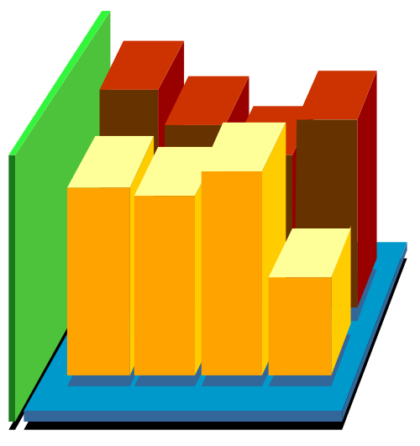
A Classification of Computerized
Databases
Fig.
Computerized Databases
Online
Internet
Off-Line
Bibliographic Databases
Numeric Databases
Full-Text Databases
Directory Databases
Special-Purpose Databases

Slide 15
Published External Secondary Sources
Guides
An excellent source of standard or recurring information
Helpful in identifying other important sources of directories, trade associations, and trade publications
One of the first sources a researcher should consult
Directories
Helpful for identifying individuals or organizations that collect specific data
Examples: Consultants and Consulting Organizations Directory, Encyclopedia of Associations, FINDEX: The Directory of Market Research Reports, Studies and Surveys, and Research Services Directory
Indices
Helpful in locating information on a particular topic in several different publications

Slide 16
Classification of Computerized Databases
Bibliographic databases are composed of citations to articles
Numeric databases contain numerical and statistical information
Full-text databases contain the complete text of the source documents comprising the database
Directory databases provide information on individuals, organizations, and services

Slide 17
Syndicated Services
Syndicated services are companies that collect and sell common pools of data of known commercial value designed to serve a number of clients
Syndicated sources can be classified based on the unit of measurement (households/consumers or institutions)
Household/consumer data may be obtained from surveys, diary panels, or electronic scanner services
Institutional data may be obtained from retailers, wholesalers, or industrial firms

Slide 18
Single-Source Data
Single-source data provide integrated information on household variables, including media consumption and purchases, and marketing variables, such as product sales, price, advertising, promotion, and in-store marketing effort
Recruit a test panel of households and meter each home's TV sets
Survey households periodically on what they read
Grocery purchases are tracked by scanners
Track retail data, such as sales, advertising, and promotion

Slide 19
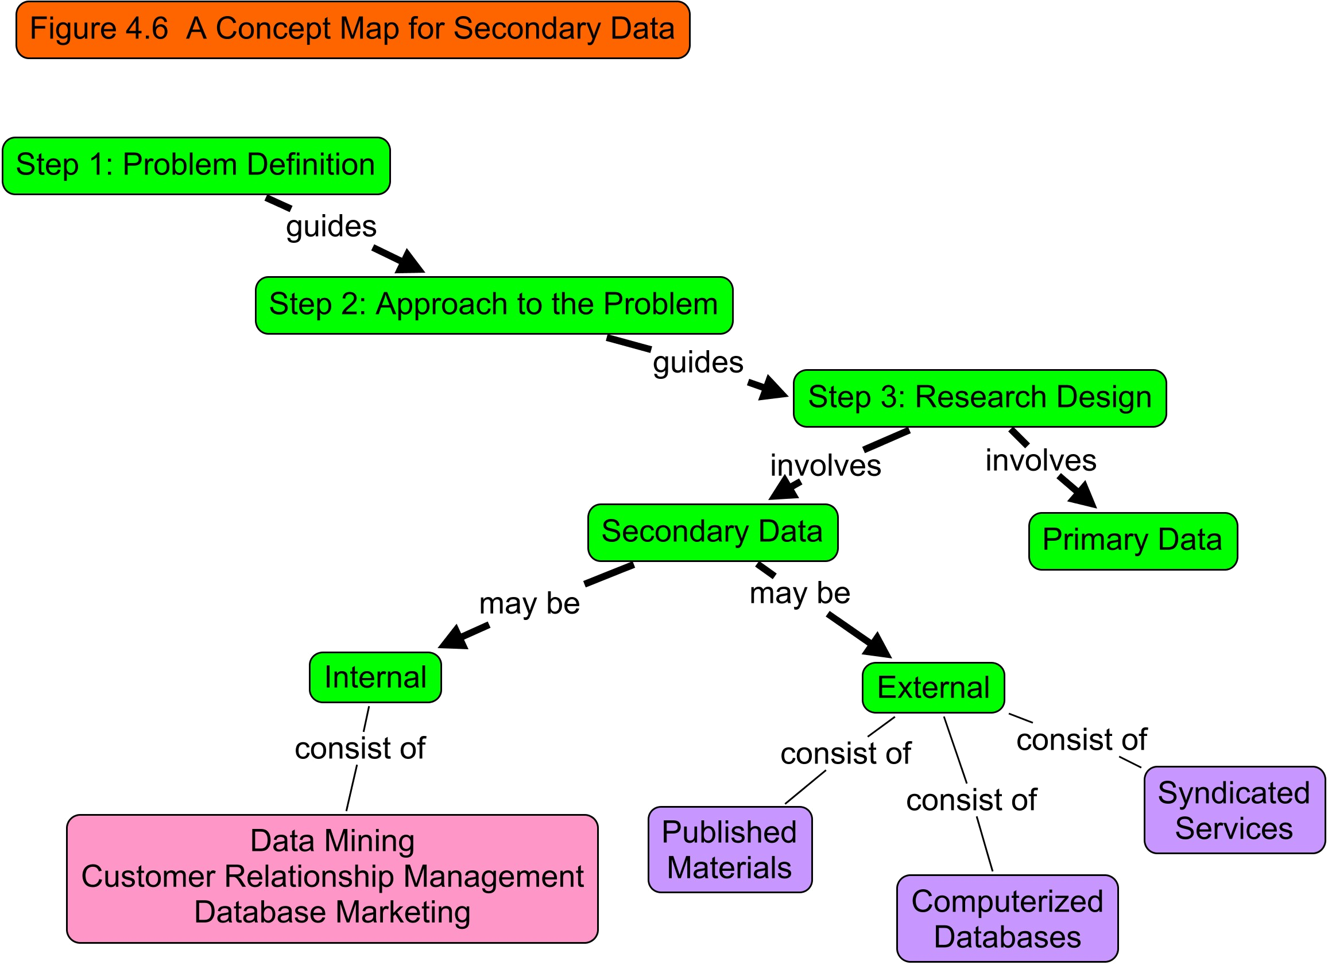

Slide 20
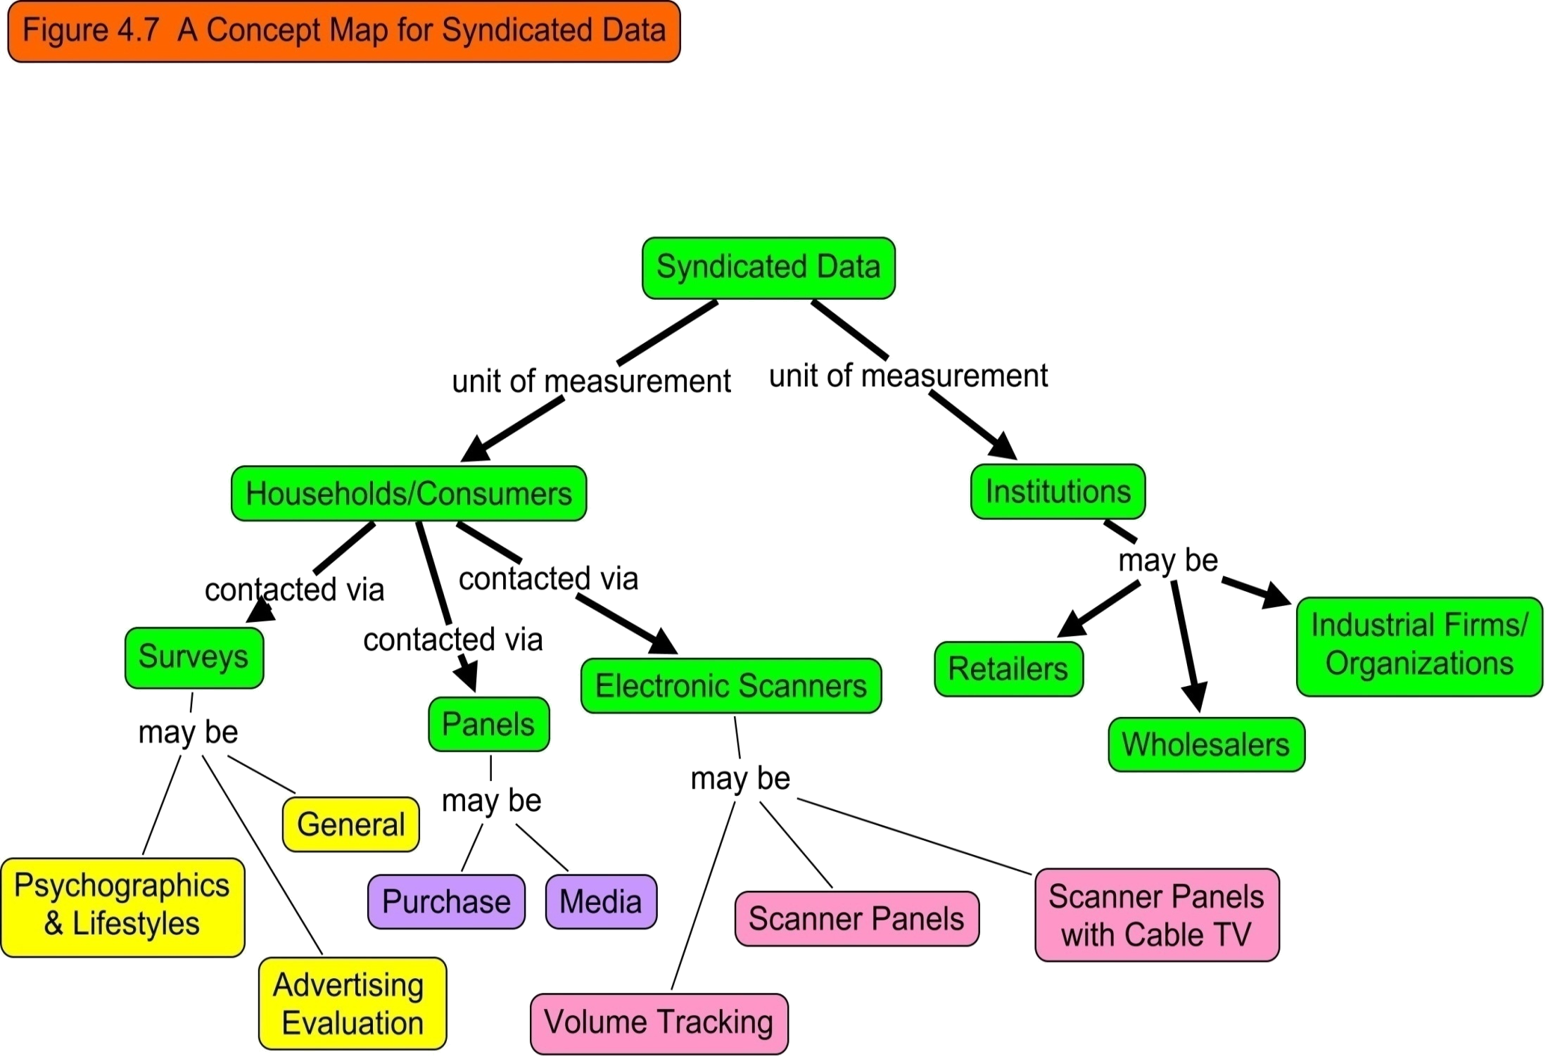

Slide 21

Exploratory Research Design:
Qualitative Research

Slide 22
A Classification of Marketing Research Data
Fig. 5.1
Marketing Research Data
Secondary Data
Primary Data
Qualitative Data
Quantitative Data
Descriptive
Causal
Survey Data
Observational and Other Data
Experimental Data

Slide 23
Qualitative Vs. Quantitative Research
Table 5.1
Qualitative Research
To gain a qualitative understanding of the underlying reasons and motivations
Small number of non-representative cases
Unstructured
Non-statistical
Develop an initial understanding
Quantitative Research
To quantify the data and generalize the results from the sample to the population of interest
Large number of representative cases
Structured
Statistical
Recommend a final course of action
Objective
Sample
Data Collection
Data Analysis
Outcome

Slide 24
A Classification of Qualitative Research Procedures
Fig. 5.2
Qualitative Research Procedures
Direct (Non- disguised)
Indirect (Disguised)
Projective Techniques
Focus Groups
Depth Interviews

Slide 25


Descriptive Research Design: Survey and Observation

Slide 26

A Classification of Survey Methods
Survey Methods
Telephone
Personal
Mail
Electronic
In-Home
Mall Intercept
Computer-Assisted Personal Interviewing
E-mail
Internet
Traditional Telephone
Computer-Assisted Telephone Interviewing

Slide 27

A Classification of Observation Methods
Classifying
Observation
Methods
Observation Methods
Personal Observation
Mechanical Observation
Audit
Content Analysis
Trace Analysis

Slide 28
Observation Methods: Personal Observation
A researcher observes actual behavior as it occurs.
The observer does not attempt to manipulate the phenomenon being observed but merely records what takes place.
For example, a researcher might record traffic counts and observe traffic flows in a department store.

Slide 29
Observation Methods: Mechanical Observation
Do not require respondents' direct participation.
  The AC Nielsen audimeter
  Turnstiles that record the number of people entering or leaving a building.
  On-site cameras (still, motion picture, or video)
  Optical scanners in supermarkets
Do require respondent involvement.
  Eye-tracking monitors
  Pupilometers
  Psychogalvanometers
  Voice pitch analyzers

Slide 30
Observation Methods: Audit
The researcher collects data by examining physical records or performing inventory analysis.
Data are collected personally by the researcher.
The data are based upon counts, usually of physical objects.
Retail and wholesale audits conducted by marketing research suppliers.

Slide 31
Observation Methods: Content Analysis
The objective, systematic, and quantitative description of the manifest content of a communication.
The unit of analysis may be words, characters (individuals or objects), themes (propositions), space and time measures (length or duration of the message), or topics (subject of the message).
Analytical categories for classifying the units are developed and the communication is broken down according to prescribed rules.

Slide 32
Observation Methods: Trace Analysis
Data collection is based on physical traces, or evidence, of past behavior.
The number of different fingerprints on a page was used to gauge the readership of various advertisements in a magazine.
The age and condition of cars in a parking lot were used to assess the affluence of customers.
The magazines people donated to charity were used to determine people's favorite magazines.
Internet visitors leave traces which can be analyzed to examine browsing and usage behavior by using cookies.

Slide 33
Relative Advantages of Observation
They permit measurement of actual behavior rather than reports of intended or preferred behavior.
There is no reporting bias, and potential bias caused by the interviewer and the interviewing process is eliminated or reduced.
Certain types of data can be collected only by observation.
If the observed phenomenon occurs frequently or is of short duration, observational methods may be cheaper and faster than survey methods.

Slide 34
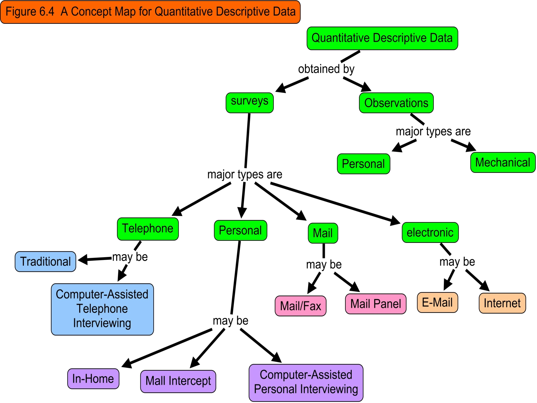

Slide 35
Causal Research Design: Experimentation

Slide 36
Definitions and Concepts
Independent variables are variables or alternatives that are manipulated and whose effects are measured and compared, e.g., price levels.
Test units are individuals, organizations, or other entities whose response to the independent variables or treatments is being examined, e.g., consumers or stores.
Dependent variables are the variables which measure the effect of the independent variables on the test units, e.g., sales, profits, and market shares.
Extraneous variables are all variables other than the independent variables that affect the response of the test units, e.g., store size, store location, and competitive effort.

